Slide 1

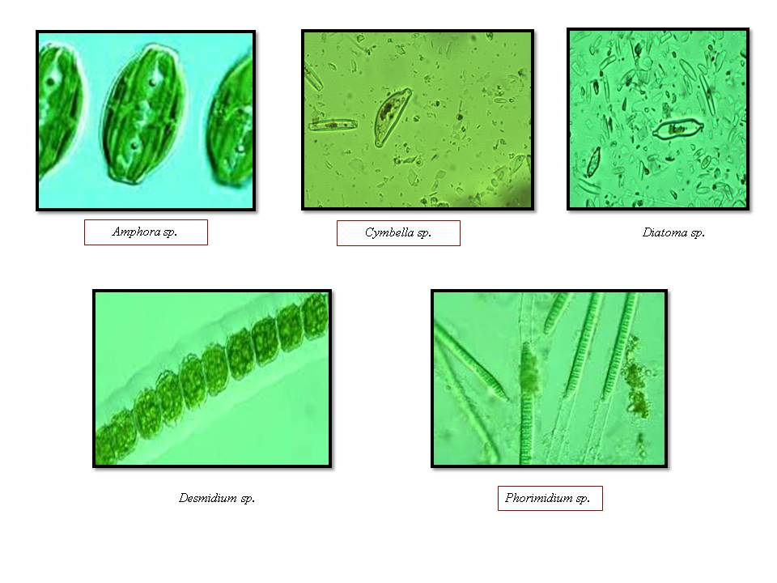
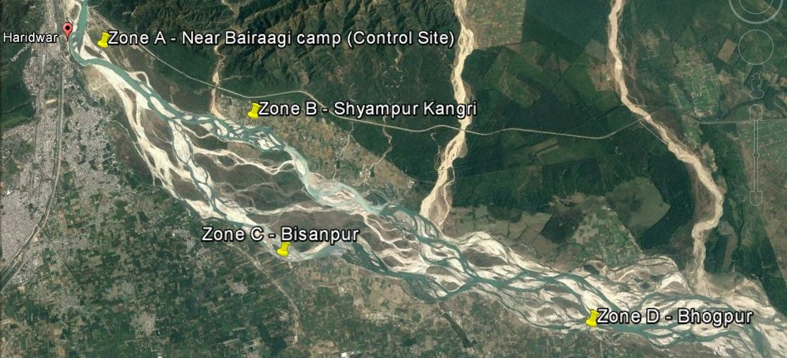
ID
AP01
STATUS OF PHYTOPLANKTON DIVERSITY IN RELATION TO WATER QUALITY OF GANGA RIVERINE SYSTEM IN HARIDWAR, UTTARAKHAND
VISHAL KAMBOJ* AND NITIN KAMBOJ
Department of Zoology and Environmental Science, Gurukula Kangri Vishwavidyalaya, Haridwar, Uttarakhand, India. Email: visikamboj94@gmail.com
Abstract:
The Bhagirathi River originated from the Gaumukh (Gangotri glacier) in western Himalaya. Alakananda River is sister stream originated from the Saptonath-Kharak group of glaciers 8km far from Badrinath. Both streams meet together at Devprayag then it is called the river Ganga (the holy river of India). The phytoplanktonic community in Ganga riverine system was represented mainly by Bacillariophyceae (75%), Chlorophyceae (15%) and Myxophyceae (7%). The most common blue-green algae were Fragilaria species followed by Diatoms species frequent in the mountainous stretch and its degree of occurrence decrease in the lower region. The Ulothrix species of Chlorophyceae algae were moderately frequent at the upper Ganga but less frequent in the lower Ganga region. Phormidium species was less frequent at upper region but moderately frequent at downstream of Ganga river. The highest resemblance between phytoplanktonic communities of two Zones, upstream and downstream was observed. Zone 1 showed 60% resemblance with these two zones. The diatoms density shows an inverse relationship with turbidity, despite the fact that high turbidity indicates the possibility of high silicate level in the water, which is essential for diatoms growth. The present study revealed that the combined impact of DO, TDS, the velocity of water, turbidity and water temperature influenced the diversity of phytoplankton population dwelling Ganga River.
Figure 3: Mean monthly variation of water quality of Ganga River from April 2017 to March 2018
Name | April | May | June | July | Aug | Sep | Oct | Nov | Dec | Jan | Feb | March
Bacillariophycaeae
Achananthes sp. | 15 | 8 | 2 | 3 | 2 | 5 | 11 | 13 | 20 | 15 | 16 | 18
Amphora ovalis | 20 | 3 | 2 | 6 | 0 | 11 | 7 | 0 | 5 | 15 | 16 | 10
Cytotella sp. | 0 | 4 | 2 | 0 | 0 | 2 | 0 | 3 | 3 | 10 | 8 | 5
Cymbella sp. | 140 | 130 | 99 | 74 | 20 | 80 | 95 | 115 | 170 | 139 | 220 | 190
Cocconeis sp. | 8 | 10 | 6 | 0 | 3 | 6 | 9 | 6 | 20 | 39 | 32 | 12
Coloneis sp | 0 | 6 | 0 | 0 | 4 | 3 | 0 | 0 | 0 | 4 | 0 | 4
Ceretoneis sp. | 10 | 9 | 0 | 0 | 0 | 10 | 7 | 21 | 25 | 8 | 21 | 12
Denticula sp. | 10 | 15 | 4 | 12 | 4 | 7 | 8 | 10 | 21 | 31 | 38 | 37
Diatoma sp. | 135 | 122 | 20 | 55 | 31 | 40 | 32 | 45 | 83 | 120 | 139 | 110
Fragilaris inflate | 150 | 160 | 90 | 80 | 20 | 120 | 96 | 152 | 108 | 185 | 240 | 190
Gyrosigma sp. | 0 | 7 | 0 | 0 | 3 | 0 | 0 | 3 | 10 | 15 | 9 | 0
Hantzschia sp. | 3 | 10 | 4 | 5 | 0 | 1 | 3 | 0 | 7 | 10 | 15 | 0
Navicula radiosa | 170 | 70 | 60 | 30 | 15 | 90 | 101 | 110 | 180 | 190 | 195 | 210
Nitzchia sp. | 50 | 74 | 81 | 91 | 29 | 70 | 89 | 100 | 150 | 180 | 100 | 85
Opephora sp. | 0 | 3 | 0 | 1 | 0 | 4 | 0 | 0 | 4 | 8 | 7 | 3
Pinnularia sp. | 10 | 8 | 10 | 5 | 0 | 8 | 3 | 7 | 1 | 25 | 17 | 27
Syendra ulna | 10 | 1 | 7 | 3 | 0 | 12 | 13 | 12 | 55 | 70 | 80 | 85
Tabellaria fenestris | 45 | 70 | 35 | 40 | 30 | 70 | 25 | 75 | 110 | 170 | 150 | 80
Tetracyclus sp. | 0 | 5 | 3 | 0 | 0 | 3 | 0 | 0 | 3 | 7 | 15 | 3
Total | 776 | 715 | 425 | 405 | 161 | 542 | 499 | 672 | 975 | 1241 | 1318 | 1081
Chlorophyceae
Closterium sp. | 0 | 8 | 10 | 0 | 0 | 1 | 0 | 5 | 15 | 10 | 3 | 7
Cosmarium sp. | 3 | 15 | 0 | 8 | 0 | 5 | 6 | 15 | 20 | 25 | 31 | 10
Cledophora sp. | 13 | 9 | 13 | 3 | 5 | 1 | 15 | 25 | 22 | 33 | 45 | 20
Desmidium sp. | 10 | 8 | 9 | 5 | 0 | 1 | 0 | 0 | 13 | 13 | 9 | 8
Hydrodictyon sp. | 13 | 9 | 0 | 0 | 0 | 5 | 0 | 0 | 3 | 5 | 0 | 10
Microspora | 15 | 11 | 0 | 3 | 0 | 13 | 3 | 12 | 8 | 17 | 27 | 21
Oedogonium sp. | 10 | 3 | 2 | 0 | 0 | 1 | 9 | 0 | 5 | 10 | 1 | 9
Stigeoclanium sp. | 15 | 16 | 7 | 8 | 0 | 5 | 0 | 8 | 3 | 6 | 22 | 10
Ulothrix zonata | 25 | 30 | 13 | 6 | 0 | 5 | 22 | 28 | 22 | 37 | 25 | 21
Zygnema sp. | 16 | 3 | 4 | 0 | 1 | 2 | 0 | 0 | 5 | 3 | 10 | 7
Total | 120 | 112 | 58 | 33 | 6 | 39 | 55 | 93 | 116 | 159 | 173 | 123
Myxophyceae
Anabaena sp. | 2 | 1 | 3 | 1 | 3 | 1 | 0 | 4 | 7 | 5 | 7 | 3
Coccochloris sp. | 3 | 2 | 3 | 0 | 0 | 3 | 0 | 0 | 3 | 2 | 0 | 5
Oscillatoria sp. | 7 | 6 | 0 | 0 | 2 | 5 | 3 | 12 | 10 | 7 | 20 | 10
Phorimidium sp. | 22 | 10 | 7 | 1 | 7 | 3 | 15 | 25 | 13 | 35 | 30 | 7
Total | 34 | 19 | 13 | 2 | 12 | 12 | 18 | 41 | 33 | 49 | 57 | 25
Figure 4: Mean monthly variation of Phytoplanktonic density (ind.m2) dwelling Ganga River (April 2017-March 2018).
Introduction:
Riverine water quality affects through the abundance, species composition, stability, productivity and physiological condition of the indigenous population of aquatic organisms. As a result, the nature and health of the aquatic communities is an expression of the quality of water. Water must be of the good quality not only for its consumption but also for its aesthetic value. Several workers have conducted their study on water quality of river Ganga in different forms of characteristics in Himalayan and plain regions, Lakra et al.,1987; Dobriyal 1991. The present study deals with the water quality of Ganga River in respect of Physico-chemical parameters and phytoplanktonic diversity.
Table 1: Mean monthly variation of phytoplankton density (ind.m2) dwelling Ganga River during April 2017 to March 2018.
Months | Shannon-Wiener diversity index
April | 2.570
May | 2.655
June | 2.452
July | 2.288
August | 2.327
September | 2.514
October | 2.423
November | 2.538
December | 2.689
January | 2.789
February | 2.760
March | 2.650
Mean+ S.D. | 2.555±0.161
Material and Methods:
Study Area: The present Study was carried out Status of Plankton diversity of Ganga River at district Haridwar (Uttarakhand). The coordinates of the district Haridwar are as follows: Latitude: 29° 56' 52.48" N Longitude: 78° 09' 36.90" E.
Sample collection: Water samples were from different sampling zones by Grab sampling method. The Water temperature (°C), Conductivity (µS/cm), pH and TDS (mg/l) were measured by TOSHCON electrochemical analyzer, TMULTI 27; Italy at the sampling location. Analytical parameters like Alkalinity ((mg/l), Total Hardness (mg/l), Dissolve Oxygen (DO) (mg/l), BOD (mg/l) were analysed in the laboratory following the standard methods (APHA, 2012; Trivedy and Goal, 1984). The collection of Phytoplankton in the entire sampling zone at day time (08:00 to 11:00 AM) by using the Plankton net (mess size= 20 μm) was used at the depth of 0.2m to 0.8 m in main stream. After collecting the Plankton sample 5% formalin is used to preserve the sample. For qualitative and quantitative analysis of plankton Sedgwick Rafter counting cell was used and after the sample was examined by using the Digital microscope. The Phytoplankton was identified by using the identification keys mentioned by Palmer (1969), Needham and Needham, (1972).
Shannon-wiener biotic index:
Shannon-Wiener index is a mathematical measure of species diversity in a community.
Figure 5: Different species of phytoplankton found in Ganga river
Table 2: Monthly mean variations in Shannon-Weiner diversity index of phytoplankton in Ganga River (April 2017-March 2018).
CONCLUSION
Based on the present study, it may be concluded that the Ganga River hosts a number of plankton species. During the study, 33 genera Bacillariophyceae (19 genera), Chlorophyceae (10 genera) and Myxophyceae (4 genera) were recorded. The family Bacillariophyceae constituted the highest species number in all the season followed by the family Chlorophyceae whereas family Myxophyceae constituted lowest species number. It was also observed that anthropogenic activity altering the fine tune of the river ecosystem and established as a major cause of aquatic habitat alteration and thus many of the species were rare. It may also conclude that combined impact of DO, TDS, the velocity of water, turbidity and water temperature influenced the diversity of phytoplankton population. The present research data will be contributed significantly to assess the status of plankton diversity in relation to water quality dwelling Ganga River.
Result and Discussion:
Physiographical Features of Ganga River:
Physiographical variables such as Embankment vegetation, boulder, Cobbles, pebbles, Gravel and sand were shown in Figure s.
Acknowledgement:
The author thanks to the Department of Science and Technology (DST), Government of India for financial support through INSPIRE program and also thanks to the Department of Zoology and Environmental Science, Gurukul Kangri Vishwavidyalaya, Haridwar for providing all the facilities to carry out this study.
References:
Dobriyal AK. An appraisal of the fishery resources of riverine ecosystem of Garhwal Central Himalaya. In. SD. Bhatt and RK. Pande (eds.), Ecology of the Mountain Water, Ashish Publishing House, New Delhi, 1991, 306-312.
Lakra WS, Agarwal NK, Singh HR. Present status of Snow trout in Garhwal Himalaya. U.P.J. Zoology, 1987; 7 (1): 85-88.
Needham JG, Needham PR. A guide to freshwater biology. Holden Day Ins., San Francisco (USA). 1962, 108.
Trivedy RK, Goel PK, Trisal CL. Practical methods in Ecology and Environmental Science, 1987.
APHA. Standard Methods for the Examination of Water and Waste Water. 22nd Edition, American Public Health Association, American Water Works Association, Water Environment Federation, 2012.
Figure 1: Satellite Map of study area showing four different Sampling Zone of Ganga River. (Source: Google earth V 6.2.2.6613. November 24, 2015)
Figure 2: Physiographic variables of Ganga River at the selected sampling zones

